Slide 1
Diphtheria
Is a bacterial infection caused by corynebacterium diphtheriae

Slide 2
Learning outcomes
State the epidemiology
Explain the pathogenesis
Outline the clinical manifestation
List the differential diagnosis
State the Diagnosis
Outline the treat ment

Slide 3
Epidemiology
Corynebacterium diphtheriae are 4 biotypes
Gravis, mitis, intermedius & belfanti
Are differentiated by colonial morphology, haemolysis & fermented reactions

Slide 4
Epidemiology cont.
Grow in selective media
Colonies are grey black in color
Are aerobic nonencapsulated non-spore forming
Mostly motile gram +ve bacilli

Slide 5
Spread by airborne,
direct contact with respiratory secretions or exudates from skin
Has carrier states in resp tract
Produces exotoxins

Slide 6
Cont.
Has low endemicity in the world
Mainly a tropical dse
Forms black grey membrane called desert sore

Slide 7
Factors affecting spread
Socio economic
Hygiene
Immunization

Slide 8
pathogenesis
Both toxigenic & nontoxigenic cause dse occasionally
Incubation is 2-4 days
Organisms remain in superficial layers of the skin & mm of resp tract.
It inhibits protein synthesis leading to tissue necrosis .

Slide 9
Pathogenesis cont.
C’C by a grey brown pseudomembrane of resp tract, pharynx, tonsils
Bleeds on touch
Causes inflammation, local paralysis of the palate

Slide 10
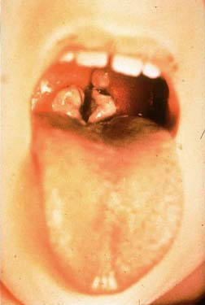
Thick grey coating over the back of the throat- may lead to suffocation

Slide 11
The toxins may affect kidney tubules & heart causing cardiomyopathy
Nerves – demyelination
Bone marrow- thrombocytopenia leading to immediate effects or 6 weeks later

Slide 12
Clinical features
Low grade fever, sore throat, dysphagia, hoarseness of voice, malaise, headache, erosive rhinitis, membrane formation
Tonsils & pharynx may be unilateral or bilateral.

Slide 13
Cont.
Membranes form deeper in the surrounding
leading to bullneck appearance
Regional lymphadenopathy
Soft tissue swelling
Upper airway obstruction
Needs mechanical intubation and tracheostomy

Slide 14
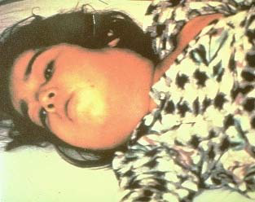
Bull neck in diphtheria

Slide 15
DDX
Streptococcal pharyngitis
Epstein bur virus
Wilson angina
Phlembitis
Thrombosis of jugular vein
Severe LTB

Slide 16
Cutaneous diphtheria
Non progressive infection of the skin
Takes time to heal
Its covered by grey brown membrane
DDX
Impetigo,

Slide 17
Cardiomyopathy
Is one of the killers
Toxic cardiomyopathy occurs in ¼ of patients with resp diphtheria
C’c by tarchycardia, low grade fever, CCF, arrhythmias

Slide 18
Toxic neuropathy
Hyperaesthesia
Paralysis
Weakness of structures on neck- dysphagia, aspiration
Cranial nerve palsy
Facial asymmetry
Polyneuropathy -- LMNL

Slide 19
DDX
Guillain barre syndrome
Paralysis of phrenic nerve – leads to sudden death
Autonomic nerves
Sweating
Ear – otitis media
Eyes – conjunctivitis
GUT

Slide 20
DIAGNOSIS
S+S
High index of suspicion
Swabs in resp tract for gram stain culture & sensitivity

Slide 21
Treatment
Passive immunization – antiserum antitoxin neutralizes free toxins
Antibiotics – erythromycin 50mg/kg/day x 2wks
Or rifampicin, clindamycin, X-pen
Throat swab be4 stopping drugs

Slide 22
Cont.
Bed rest
Isolate the patient
Immunize the staff, house hold or contacts with a booster vaccine
Unimmunized house hold contacts should be given benzathine penicillin

Slide 23
Prognosis
Depends on
1. virulence of the organism
2. Age – very young & very old
3. Site of infection
4. antitoxins
5. well immunized
Notes:
When they recover give a booster dose of diphtheria vaccine
If not immunized – primary series of immunization

